Slide 1
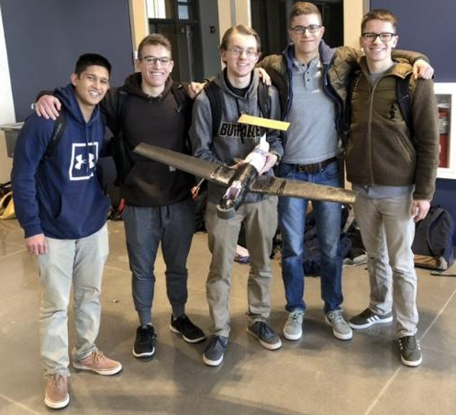
Ralphie VI
-
ASEN 2004 Glider Design Lab, 2020
Section 303 - Group 9
Ryan Block, Zach Lesan, Cole MacPherson, Scott Mansfield, Ankrit Uprety

Slide 2
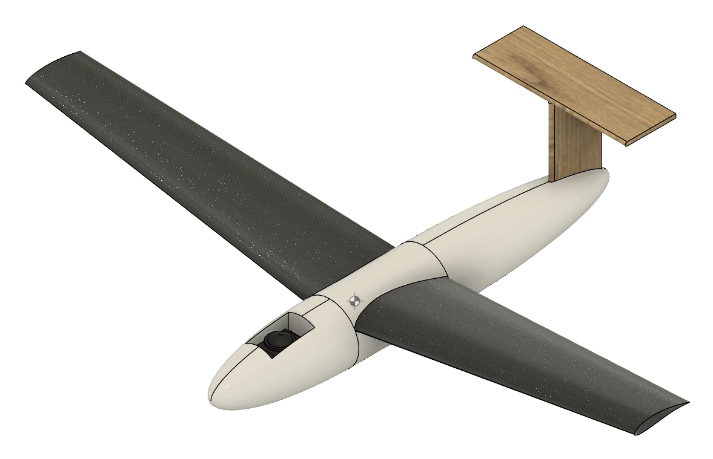
Tri View
Characteristic
Wingspan | 0.995 m
Wing area | 0.12 m^2
Aspect Ratio | 7.87
Airfoil | GOE 430
Root chord | 6”
Tip chord | 4”
Length | 0.65
Weight | 0.7 kg
Wing Loading | 42.6 N/m^2

Slide 3
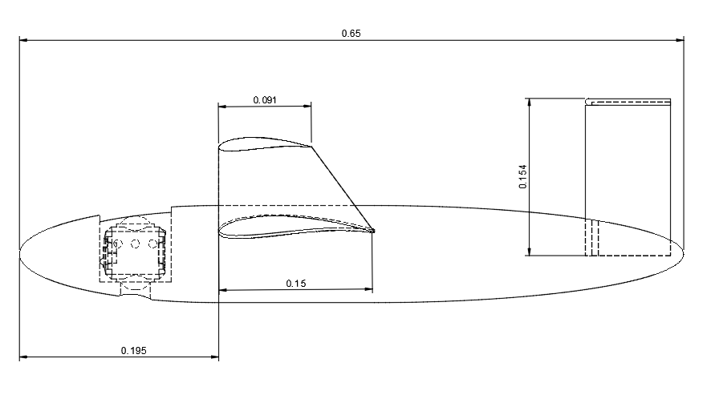
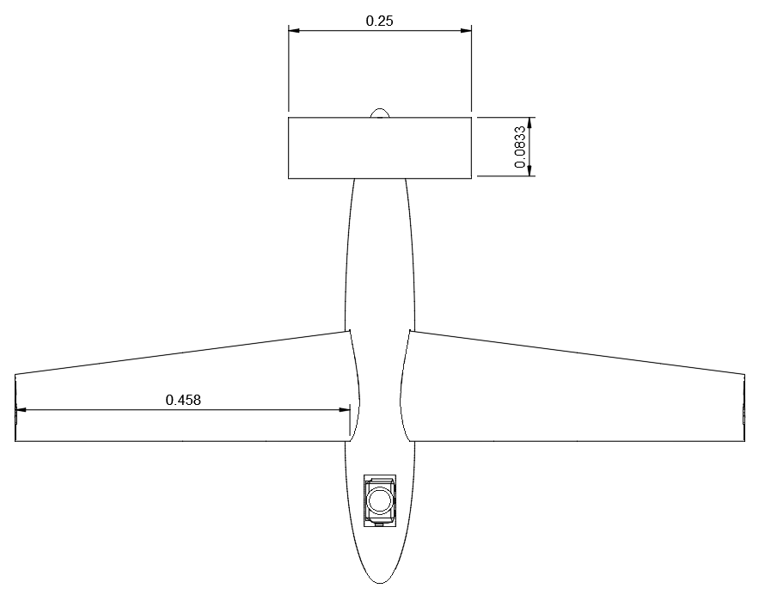
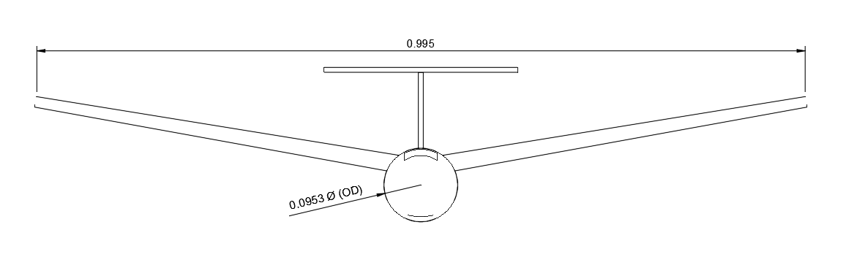
Side
Top
Front

Slide 4
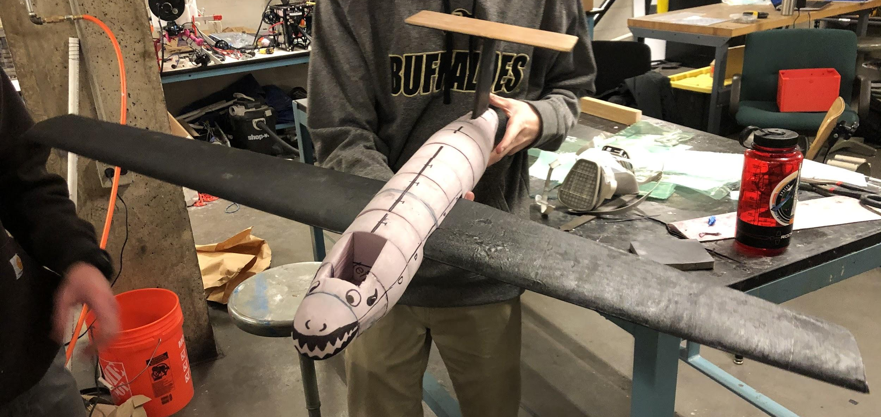
Initial Construction

Slide 5
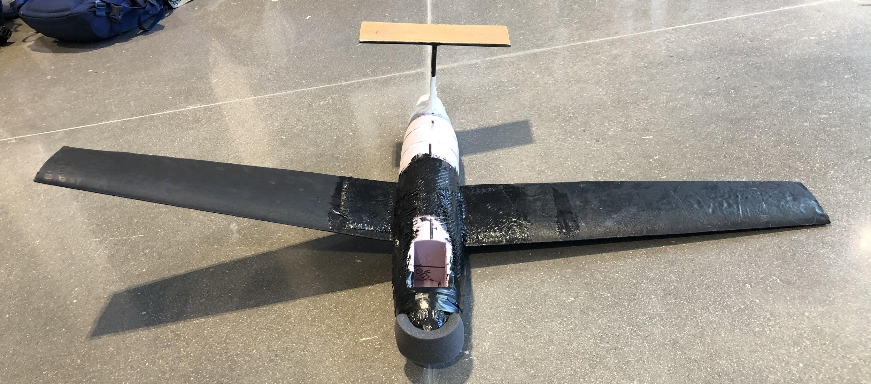
Flight Day Configuration (Post Initial Tests)

Slide 6
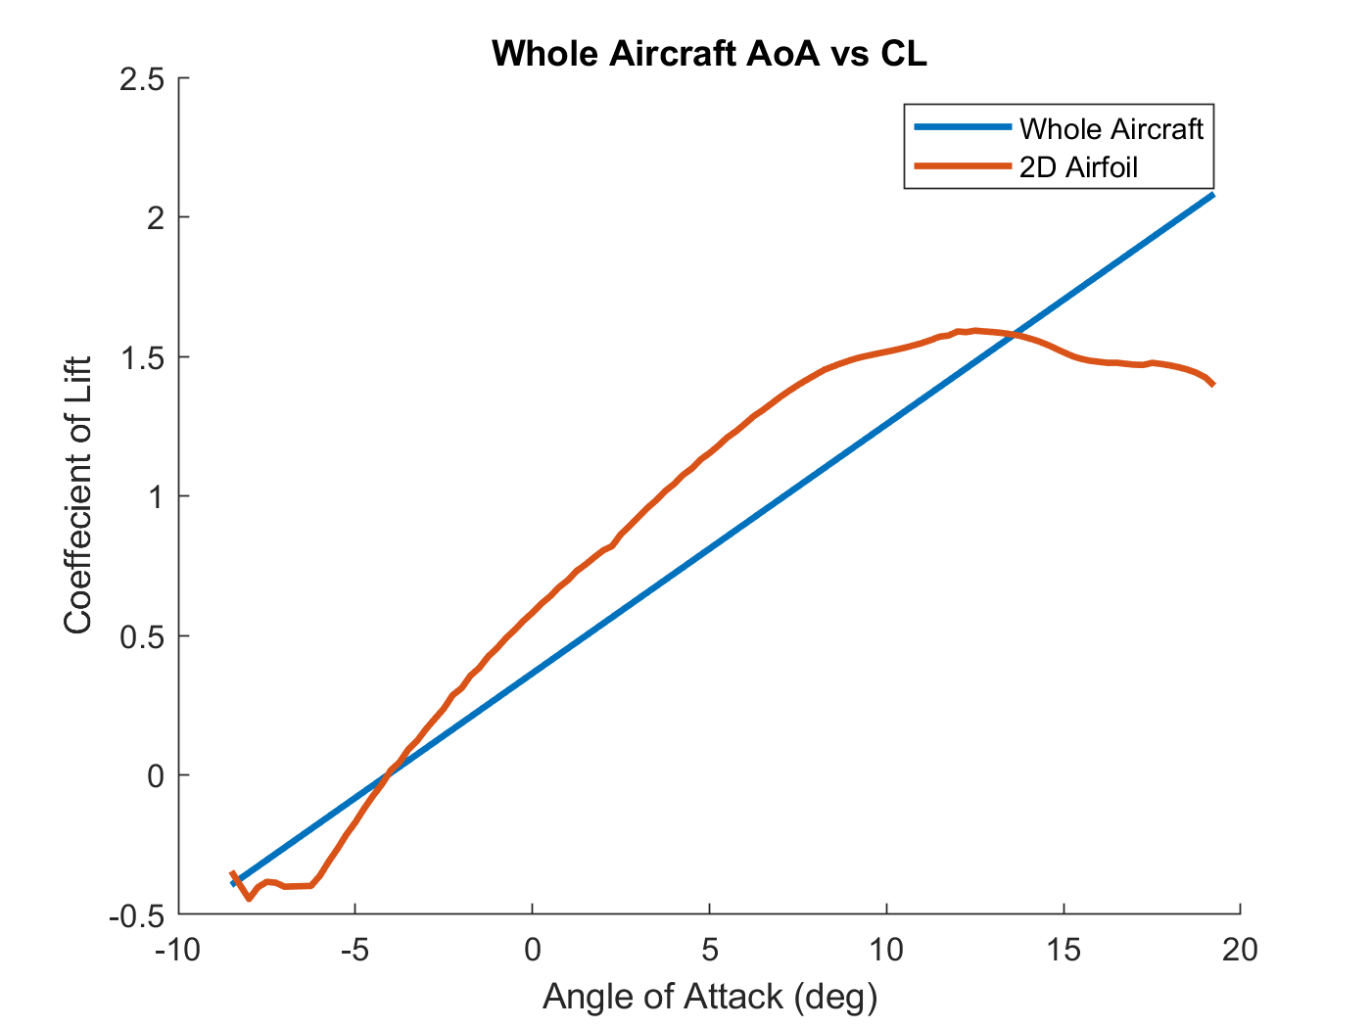
Coefficient of Lift vs Angle of Attack
Linear vs. Curved
Expected given model’s assumptions
Coefficient of lift is lower for the whole aircraft compared to 2D airfoil
Validates model

Slide 7
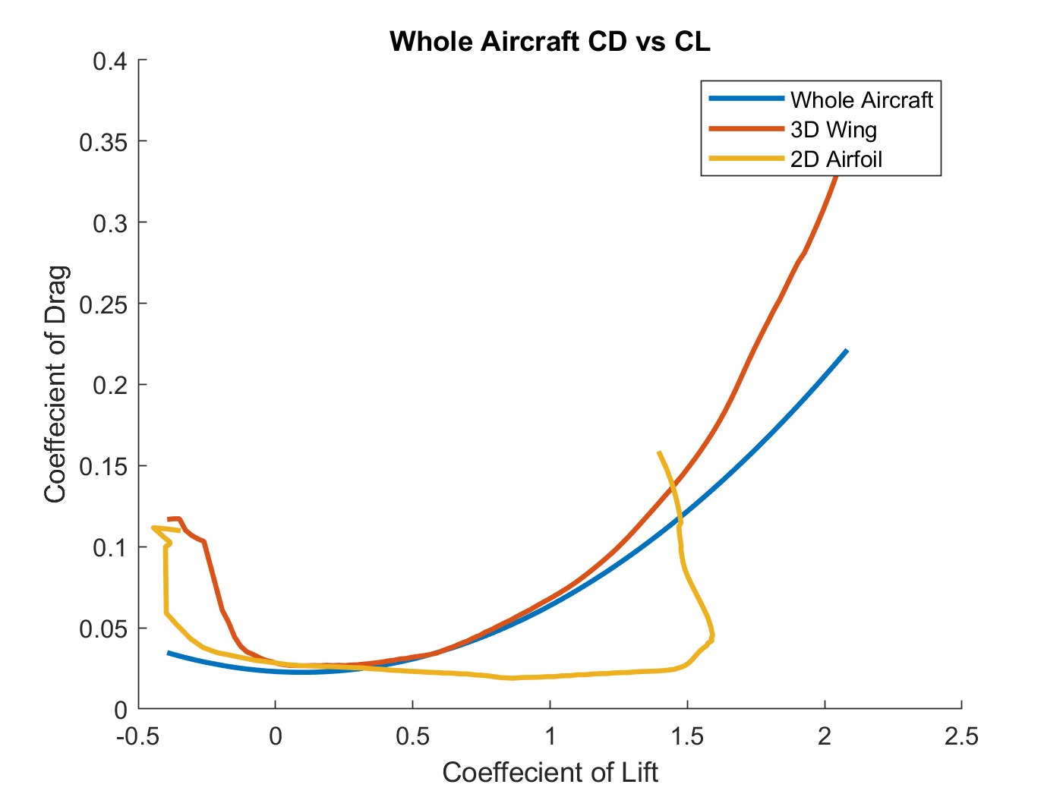
Drag Polar
Whole aircraft slightly less than 3D wing, suggests inaccurate model
Does not include interference drag
One of the largest sources of error in design process

Slide 8
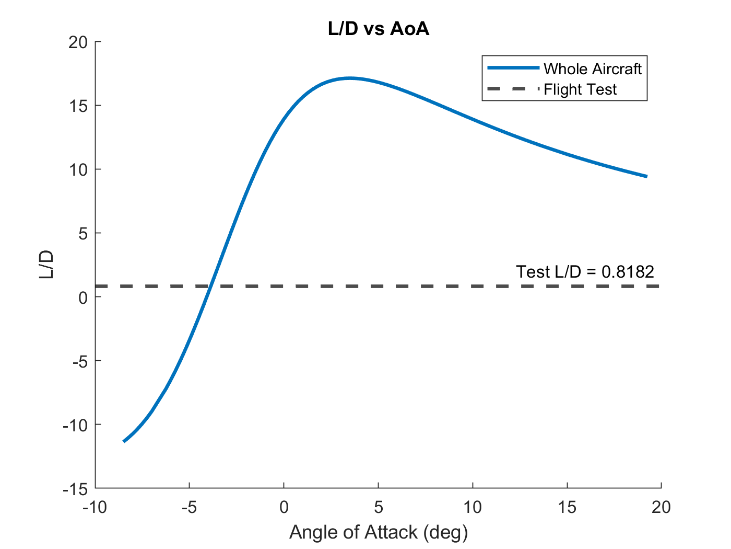
L/D vs Angle of Attack
Good curve trend
Expected results
Did not match experimental results
Overestimation due to coefficient of drag calculations

Slide 9
Calculations vs Results
 | Calculated | Flight Test
Max Range | 119.78 m | 18 m
L/D Max | 17.07 | 0.82
Velocity for L/D Max | 11.11 m/s | N/A*
Stall Velocity | 7.24 m/s | N/A
*A velocity of 57.3 m/s was calculated assuming SLUF, which our glider never achieved

Slide 10
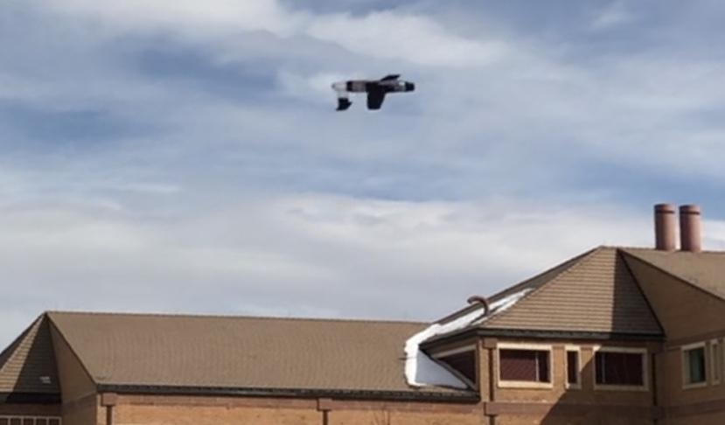
Performance Discussion
Predicted Performance
119 m max range
Low velocity required, 11 m/s
CG at quarter chord with no ballast
Actual Performance
18 m max range, barely flew
Much higher velocity needed than expected, overweight
Required 60 g ballast to move CG to quarter chord

Slide 11
Performance Discussion
Errors in Analytical Data:
Drag Polar
Whole Aircraft less than 3D Wing
Lack of interference drag
Reynolds number discrepancies
Skin Friction Drag Coefficient
Flat plate estimation
Final glider design had very rough surface

Slide 12
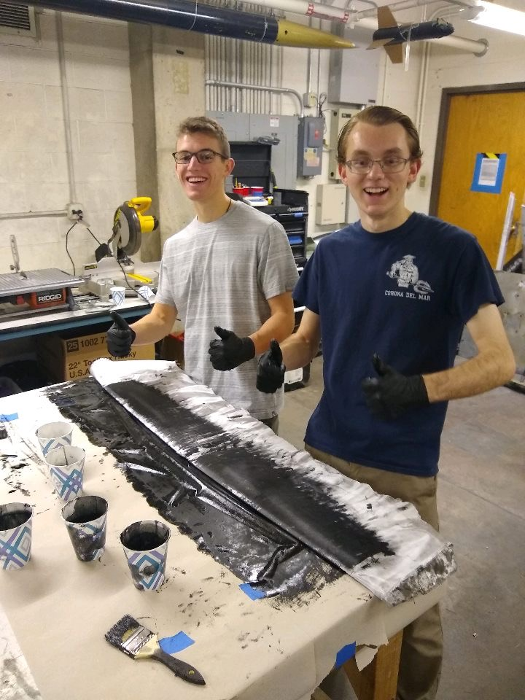
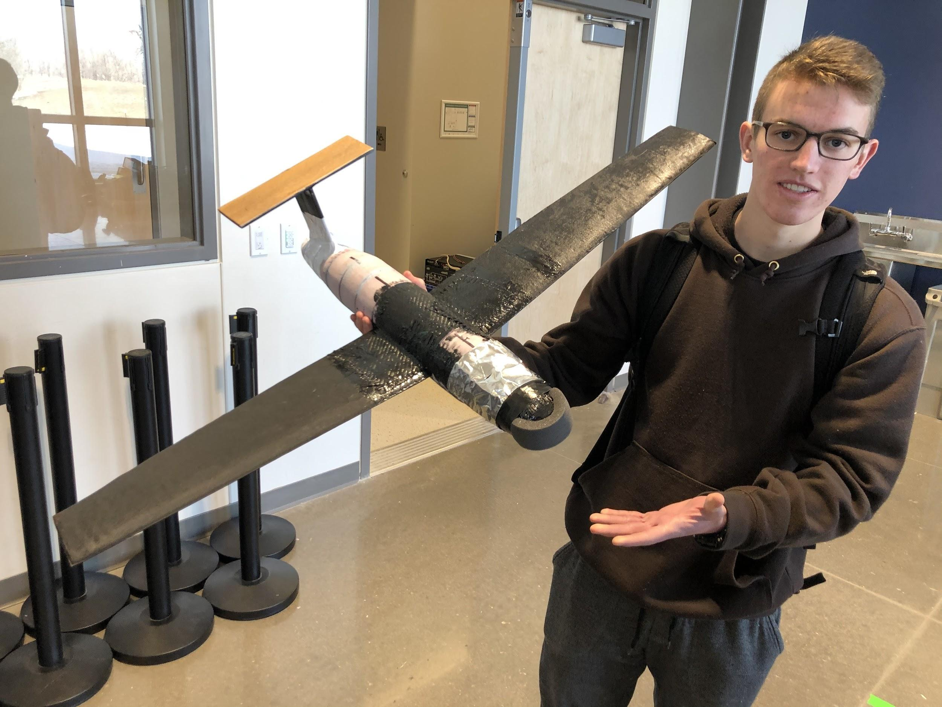
Performance Discussion
Inconsistencies between model and construction:
Dowels, carbon fiber, duct tape
Add weight, skin friction, and interference drag
Would change value of CD0
Flight Test Data Error:
Very little, the glider did not go far
Range finder error

Slide 13
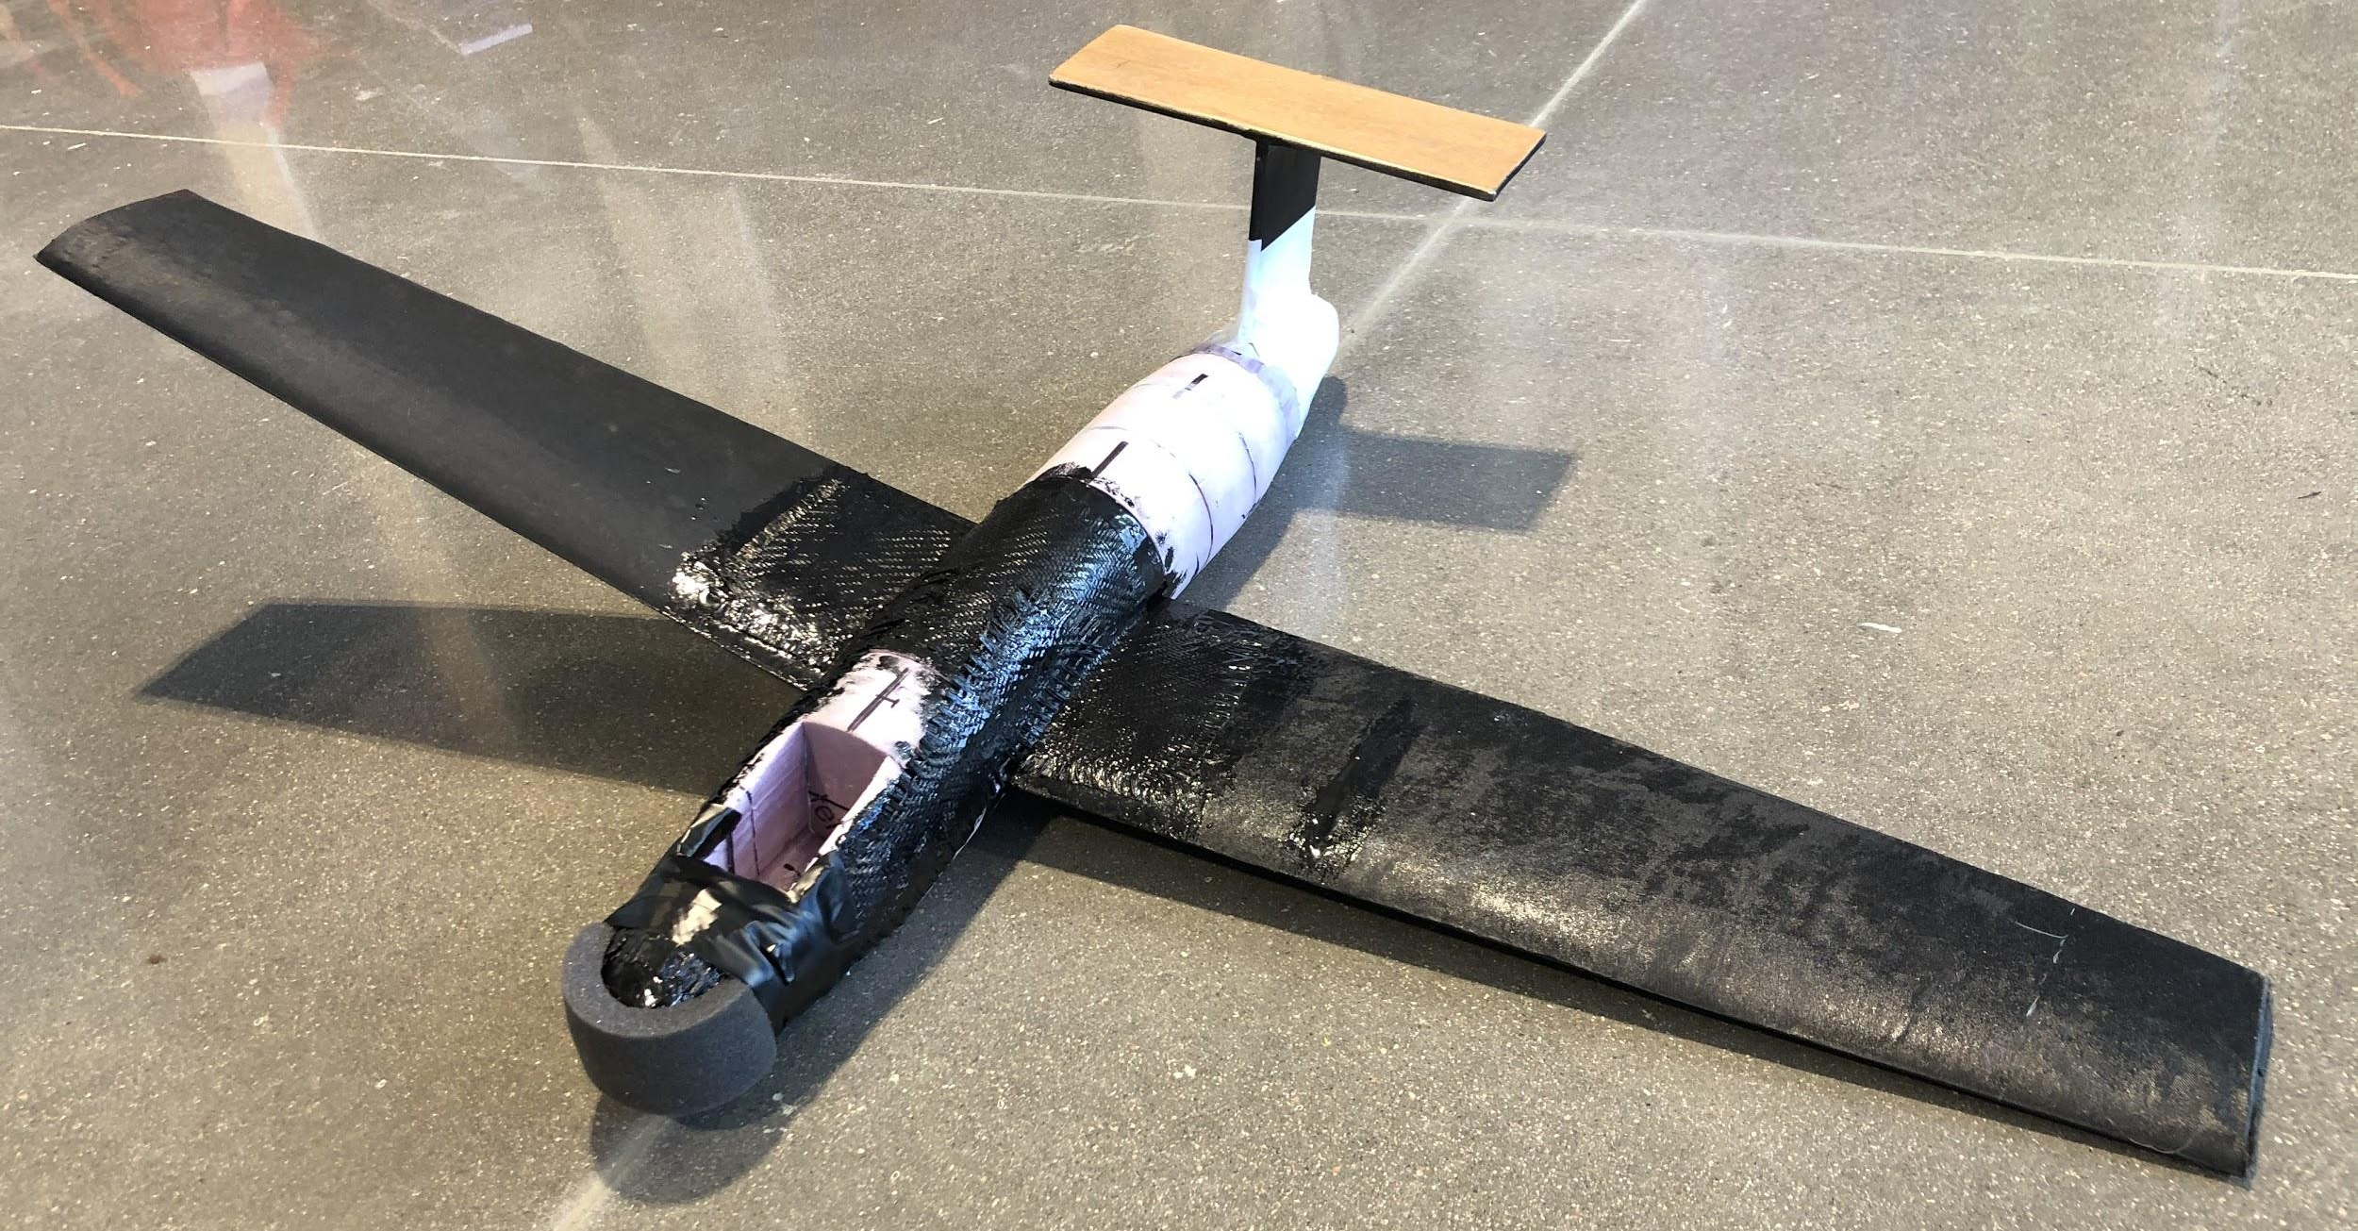
Takeaways: What We Would Do Differently
Smaller, lighter, slower
Better execution of composite use
Reduced fuselage volume
Smaller wetted area
Better variable tail angle design
More flight tests
Standardized launching procedure

Slide 14
Takeaways - Flight Test vs. Paper Design
Execution of Design deviated heavily from paper design
Dowel rods, carbon fiber, duct tape, safety foam
Paper design used a lot of estimations; Flight test showed what was significantly off.
Paper design is useful for initial construction, but its capabilities are limited
Enlightening and challenging experience, demonstrates the limit of models

Slide 15
References
Anderson, J. D., Introduction to Flight, 8thEd., McGraw Hill (2012).
Phillips, WF, Minimizing Induced Drag with Geometric and Aerodynamic Twist, CFD Validation,
Utah State University, AIAA (2005). https://arc-aiaa-org.colorado.idm.oclc.org/doi/pdf/10.2514/6.2005-1034
Kentfield, JAC, Fuselage-Wing Interference Drag Of Aircraft With Relatively Short Pod-Type Fuselages, University of Calgary, AIAA (2002). https://arc-aiaa-org.colorado.idm.oclc.org/doi/10.2514/6.2002-708
Chen, T.M, Katz, J, Induced Drag of High-Aspect Ratio Wings,
SDSU, AIAA (2004). https://arc-aiaa-org.colorado.idm.oclc.org/doi/pdf/10.2514/6.2004-38

